Slide 1
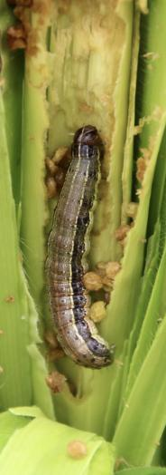
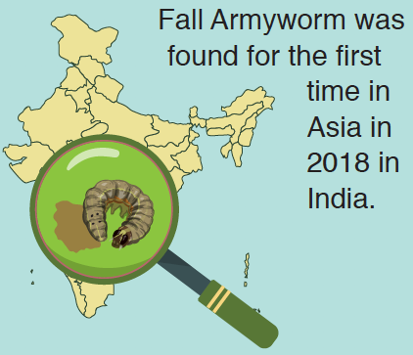
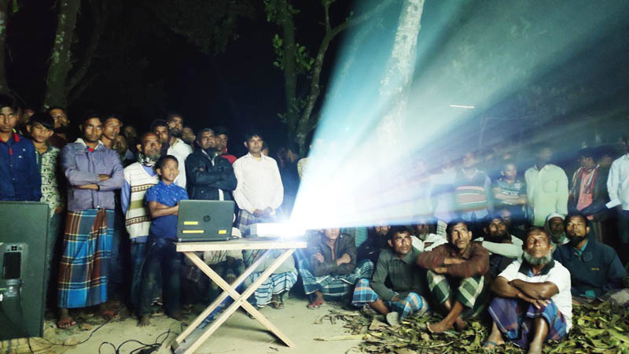
Scaling-out awareness of Fall Armyworm IPM:
Experiences in Bangladesh with SAWBO
Timothy J. Krupnik | International Maize and Wheat Improvement center (CIMMYT)
Notes:
Tim to present this slide

Slide 2
The global spread of FAW as an invasive pest
Why is Fall Armyworm a concern?
Numerous sinks (polyphagous)
High fecundity (reproductive rate)
Large range of environmental and habitat suitability
Very high dispersal range (large number of sources and sinks)
Rapid invasion in Africa: 13.5 mill tons of maize worth US$ 3 billion lost (Dey et al. 2017)
The global spread of Fall Armyworm since 2015
Invasion in Bangladesh
Monitoring began in October 2018 by BARI
Detection in November of 2018
Early attack affected 14 districts in the winter 2018-19 seasons
Now found in all districts
Animation courtesy of F. Baudron (CIMMYT)
Notes:
Tim to present this slide

Slide 3
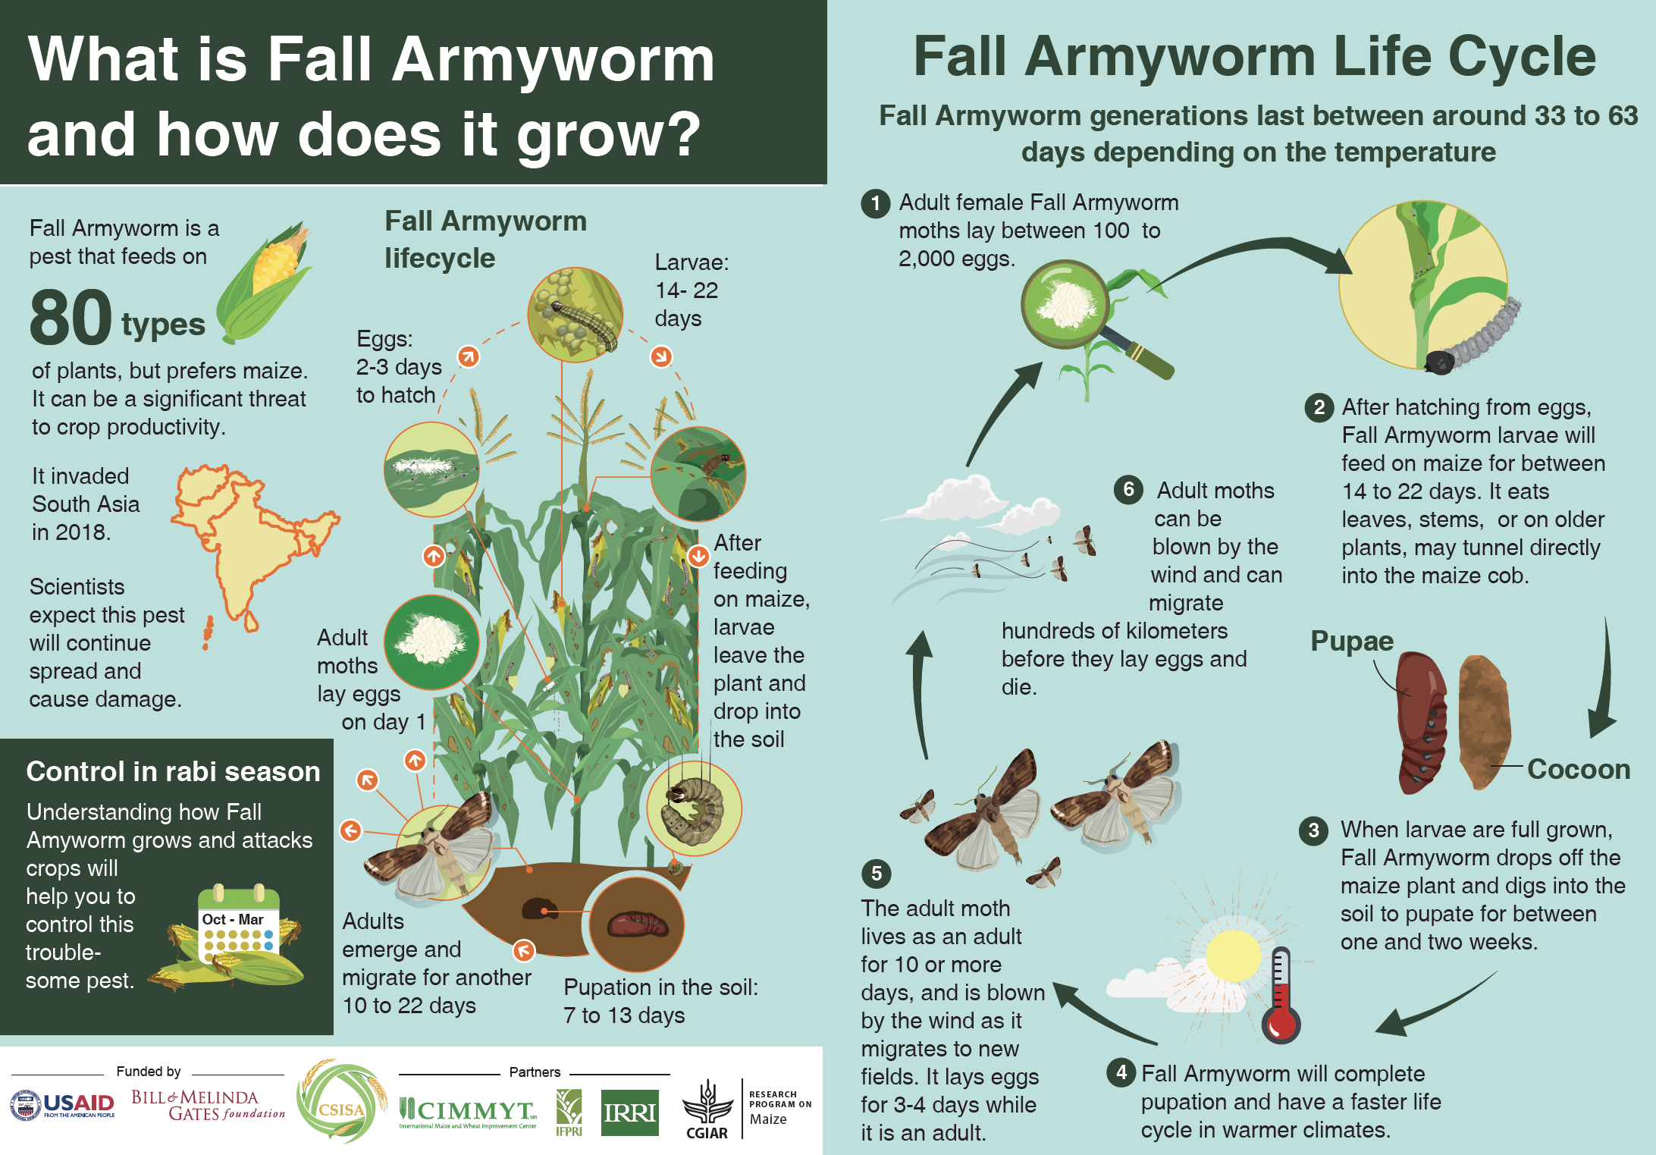
Akhter
Notes:
Tim to present this slide

Slide 4
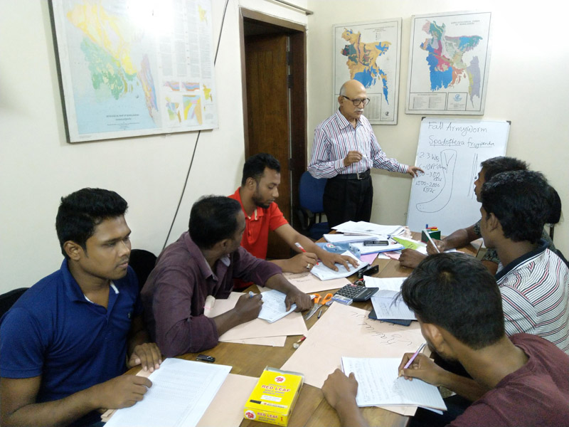
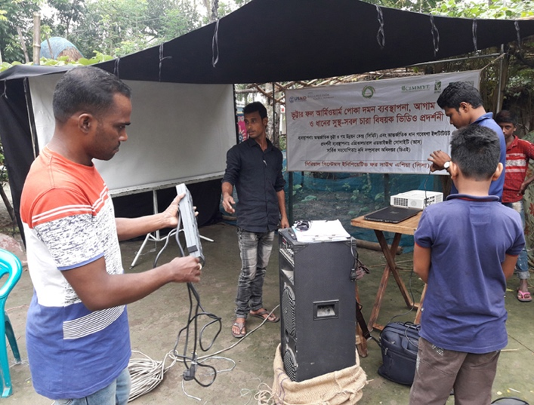
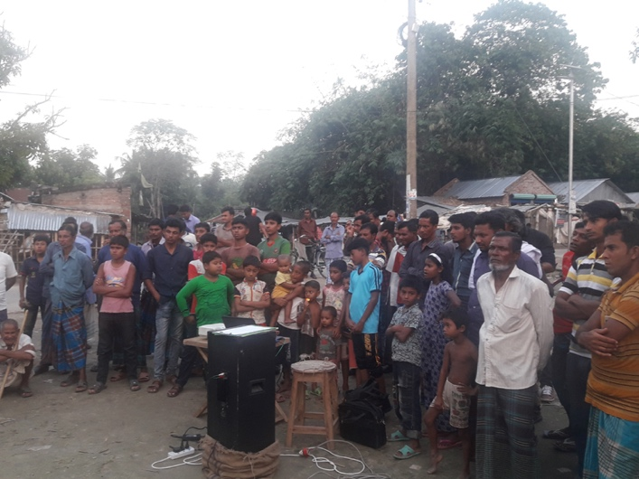
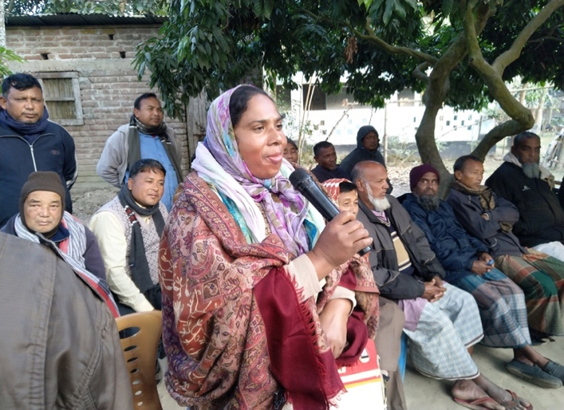
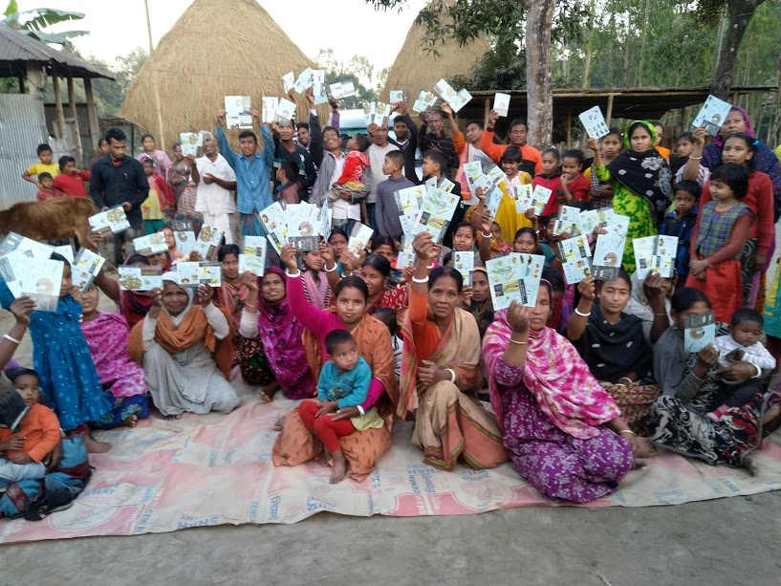
Mass awareness raising through partnerships and SAWBO
Partnerships for publicity!
Governmental partners: Agricultural Information Services (AIS), the Department of Agricultural extension
Non-Governmental Partners: Agricultural Advisory Society (AAS)
Initial focus on key maize growing locations at risk of FAW
Targeted video shows in markets, farmers’ groups, integrated pest management clubs
Combined with entertaining videos (captures audience)
Leaflet and information distribution, Q&A
Notes:
Tim to present this slide

Slide 5
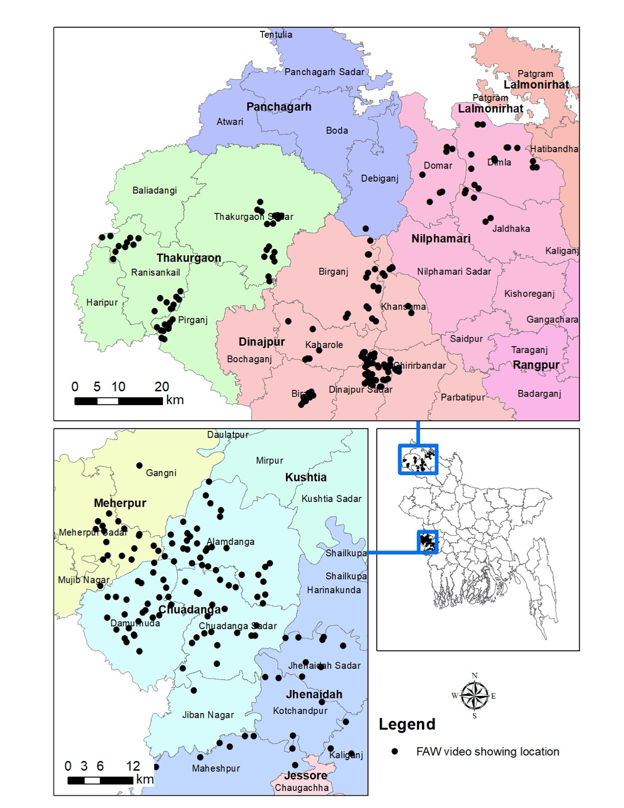
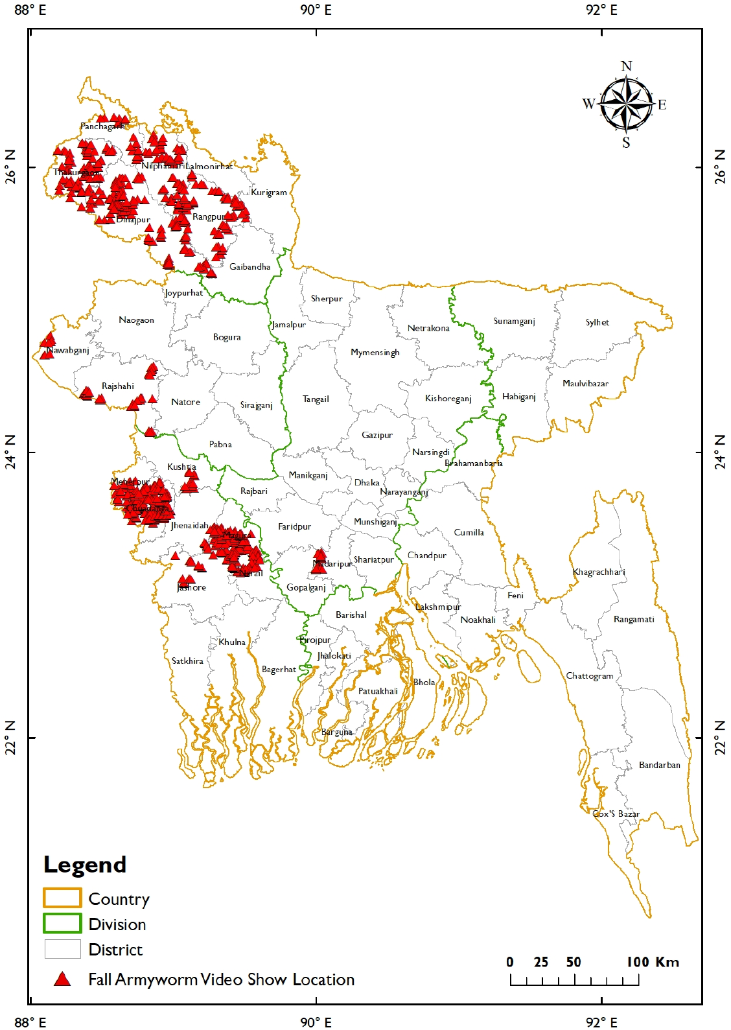
Mass awareness raising through partnerships and SAWBO
Preparing for Fall Armyworm in the 2018-19 maize season (before April ‘19)
Prior to large-scale infestation, video shows were conducted in 224 villages
12,849 farmer viewers (32% women)
Expanding in the 2019-20 season (before Feb ‘20)
921 villages
132,385 farmer viewers (23% women)
138,745 infographic leaflets distributed
Notes:
Tim to present this slide

Slide 6
Reaching scale – direct link to Govt. websites in all 64 districts
https://www.bangladesh.gov.bd/index.php?lang=en
Notes:
Tim to present this slide

Slide 7
Akhter
Notes:
Tim to present this slide

